Slide 1
Water Pollution Detection using sensing and computer vision.
Guide : Dr Raja Vara Prasad
K.Sravani (S20170020216)
T.Chandana (S20170020246)

Slide 2
Overview
Objective
Workflow
Literature Review
Previous work
Work done
Results
Challenges
References

Slide 3
Objective
To efficiently predict if the water body is polluted or not with the help of sensor data collected by placing sensors on water.
To take a picture of the water body with the help of drone and to predict if it is polluted or not by running a computer vision model.

Slide 4

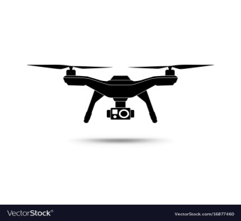
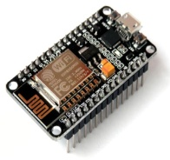
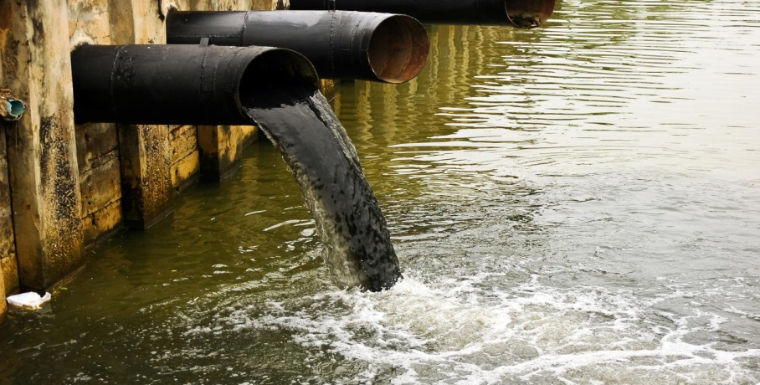
Workflow
Sensor data
Image of the water body
. . .
Nodemcu 1
Nodemcu 2
Nodemcu n
Prediction based on computer vision analysis of image data
Result based on sensor data

Slide 5
Deliverables
Module 1
Sensor based water pollution measure
Module 2
Yolo v4 for trash on water detection
Module 3
Yolo v4 for algae detection
Module 4
Mask RCNN for algae on water
Module 5
Multi class models with mask rcnn and yolo v4
Module 6
Integrating models with drone
Module 7
Integrating models with web app and mobile app

Slide 6
Literature Review
Protocol Explored:
Message Queueing Telemetry Transport(MQTT)
Lightweight Publish and Subscribe Protocol.
Designed for Constrained devices with low Bandwidth.
Have different Quality of Service options.
Both client and broker can publish and subscribe.
Client 1
MQTT
Broker
Publish
Publish
Client 2
Subscribe
Subscribe

Slide 7
Literature Review
Object Detection
It has both Object Localization(Bounding boxes) and Class prediction(Label classification)
There are 3 well known object detectors:
RCNN’ s and their variants (eg: Fast RCNN, Faster RCNN, Mask R-CNN).
YOLO-You only look once.
SSD-Single shot detector.

Slide 8
Process of object detection
There are three steps in any object detection task :
Data Collection and labelling (with LabelImg).
Prepare the dataset for training.
Generate the weight files and use this ‘.h5’ or ‘.weights’ file for prediction on new image.
Data Collection
Cleaning and Preprocessing
Training (weights generation)
Testing

Slide 9
Literature Review(contd..)
YOLO object Detector:
You only look once (YOLO) is a state-of-the-art, real-time object detection system. On a Pascal Titan X it processes images at 30 FPS and has a mAP of 57.9% on COCO test-dev.
YOLO v4 claims to have state-of-the-art accuracy while maintains a high processing frame rate. It achieves an accuracy of 43.5% AP (65.7% AP₅₀ ) for the MS COCO with an approximately 65 FPS inference speed on Tesla V100.

Slide 10
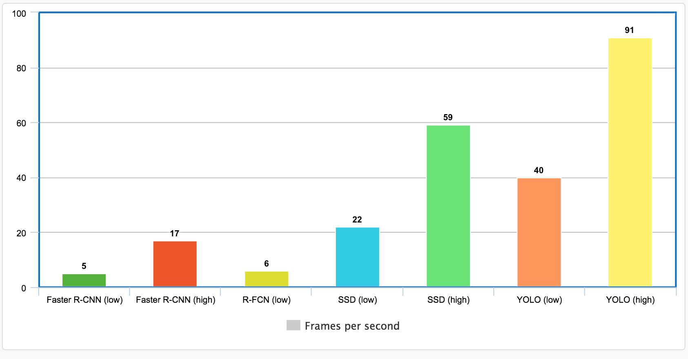
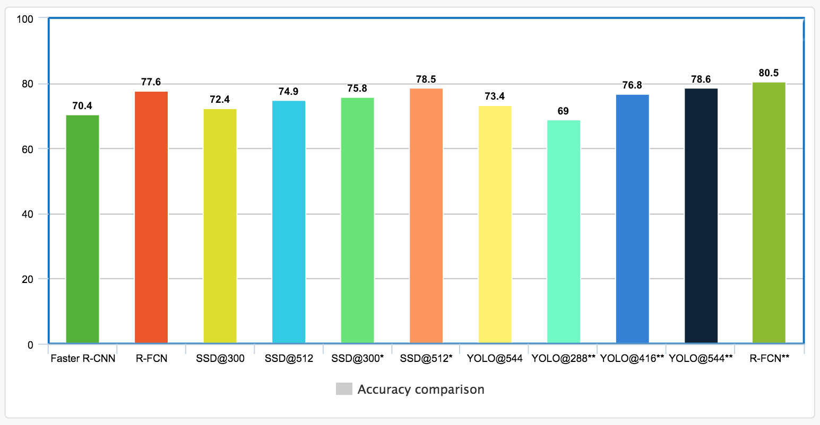
Speed Comparison Vs Accuracy Comparison

Slide 11
Mask R-CNN
Mask R-CNN is a state-of-the-art framework for Image Segmentation tasks.
The Mask R-CNN framework is built on top of Faster R-CNN.
So, for a given image, Mask R-CNN, in addition to the class label and bounding box coordinates for each object, will also return the object mask.

Slide 12
Previous work
Data is collected from 2 different sensors through NodeMcu and it is sent to gateway node(raspberry pi).
The protocol through which the data is sent from end nodes to gateway node is MQTT(Message Queueing Telemetry Transport).
Multithreading is used to send data from multiple clients simultaneously without collision.
Network Topology : STAR
Data from this gateway is sent and saved in firebase realtime database.

Slide 13

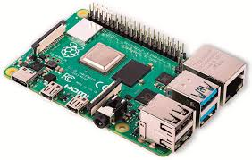
Previous Work(Contd..)
Nodemcu 1
MQTT
Sensor1
MQTT
Sensor2
Raspberry pi
Nodemcu 2

Slide 14
Sensor data
Sensor Name | Acceptable range
Conductivity sensor | 300 to 800 𝝁S/cm
PH sensor | 6.5 to 8.5
Turbidity sensor | ≤ 5 NTU
Dissolved oxygen | ≥ 8 mg/l

Slide 15
Previous work
Object detection models:
Data Collection
Didn’t have proper labelled dataset available
Did web scraping from different stock image sites like shutterstock, istock and collected images of algae and trash on water.
Collected 200 images of water with trash on its surface and 200 images of algae on water.

Slide 16
Previous Work(Contd..)
Data labelling and preprocessing:
Since the dataset is very small, we tripled the dataset using data augmentation techniques like noise, crop, flip on roboflow.ai.
Labelled these 1200 images in voc format(.xml) using a tool called LabelImg.
Dataset
Data Augmentation
(Roboflow.ai)
Labelling(.xml)
Yolo format(txt)

Slide 17
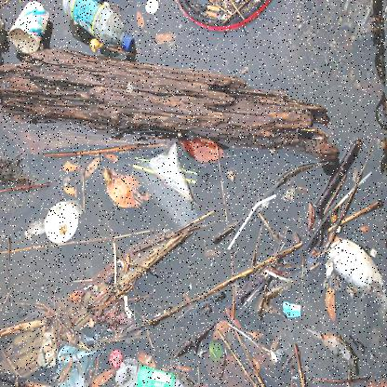
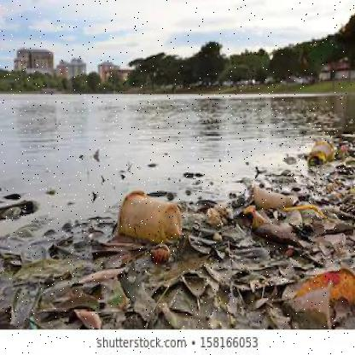
Sample images
Trash on water:

Slide 18
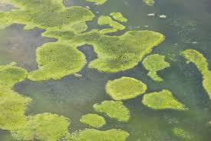
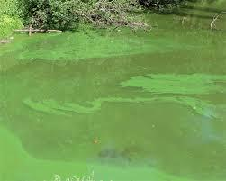
Sample images:
Algae water

Slide 19
Previous Work(contd..)
Model 1 : Trash on water detection
Transfer learning on darknet model(darkent.conv.137) with YOLO V4.
Train test split: 90% training data,10%test data
Generated train.txt and test.txt files that contains the paths to all the images of training set and test set respectively.
Classes: Trash_on_water(single class)
Iterations: 5000
Batch size: 32
Mean Average Precision(mAp) : 70%

Slide 20
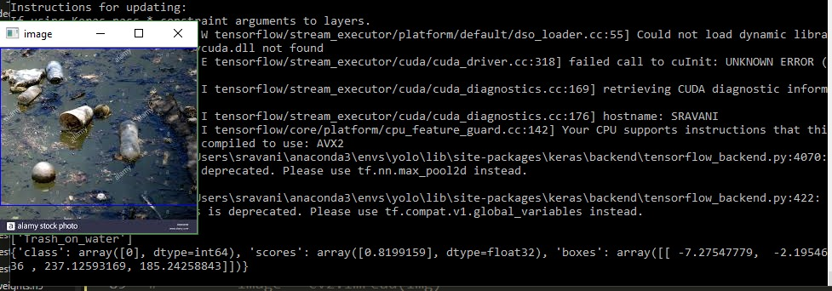
Results

Slide 21
Previous Work(contd..)
Model 2 : Algae Detection
Transfer learning on darknet model(darkent.conv.137) with YOLO V4.
Train test split: 90% training data,10%test data.
Generated train.txt and test.txt files that contains the paths to all the images of training set and test set respectively.
Classes: algae(single class)
Iterations: 5000
Batch size: 32
Mean Average Precision(mAp) : 81.43

Slide 22
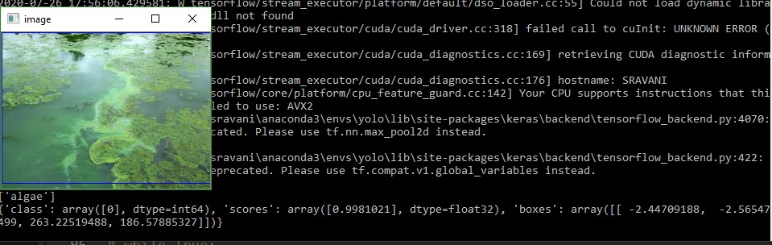
Results

Slide 23
Previous Work(Contd..)
Model 3 : Algae on water detection
Transfer learning with pre trained MS COCO as base model with mask RCNN.
Initialized the last 3 layers weights of the pretrained MASK RCNN COCO model and retrained the last three layers with a new labelled dataset of algae.
Training images:600
Batch Size:40
Epochs:50
Train Accuracy: 87%
Test Accuracy: 82.4%

Slide 24
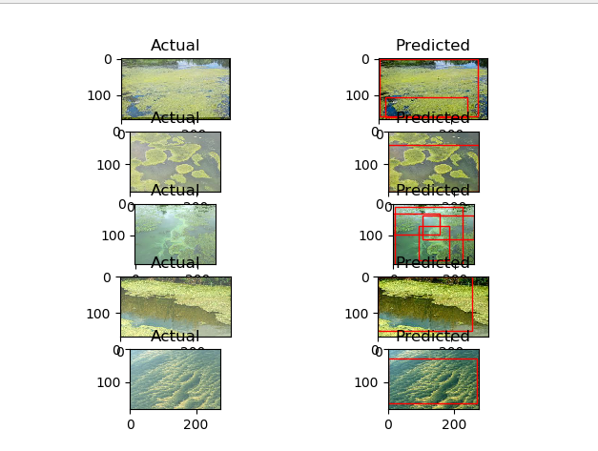
Results

Slide 25
Previous Work (Multiclass Models)
Model 1: YOLO V4 with Darknet(multi class model )
Train test split: 90% training data,10%test data
Generated train.txt and test.txt files that contains the paths to all the images of training set and test set respectively.
Dataset size: 1200
Classes: algae,Trash_on_water(multi class)
Iterations: 10,000
Batch size: 32
Mean Average Precision(mAp) : 80%

Slide 26
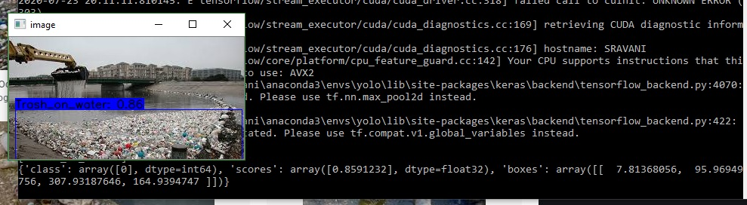
Results (Contd..)

Slide 27
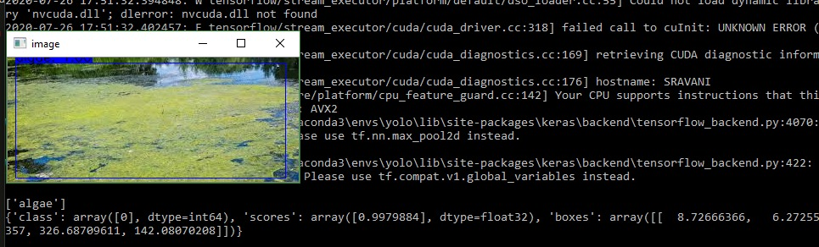
Results (Contd..)

Slide 28
Previous Work (Contd…)
Model 2 : MASK RCNN with two classes.
Train test split: 90% training data,10%test data
Generated dictionary of image data that contains the paths to all the images of training set and test set respectively by parsing xml files.
Masked all the images with numpy.
Dataset size: 1200
Classes: algae,Trash_on_water(multi class)
Epochs: 500
Batch size: 32
Mean Average Precision(mAp) : 92%

Slide 29
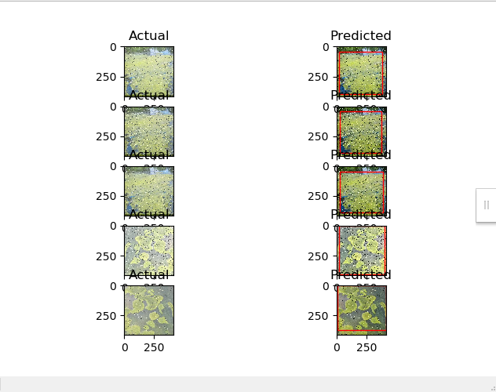
Results

Slide 30
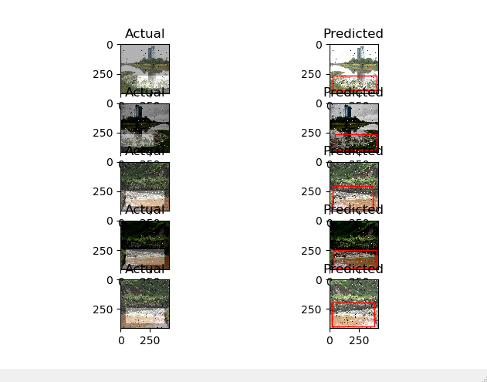
Results(contd..)

Slide 31
Integrated the models to Flask Api
Built a basic flask web app
Constructed api’s to integrate these models to flask app
Requirements for testing :
Cudnn
Python 3.6
Opencv
Keras
Tensorflow.

Slide 32
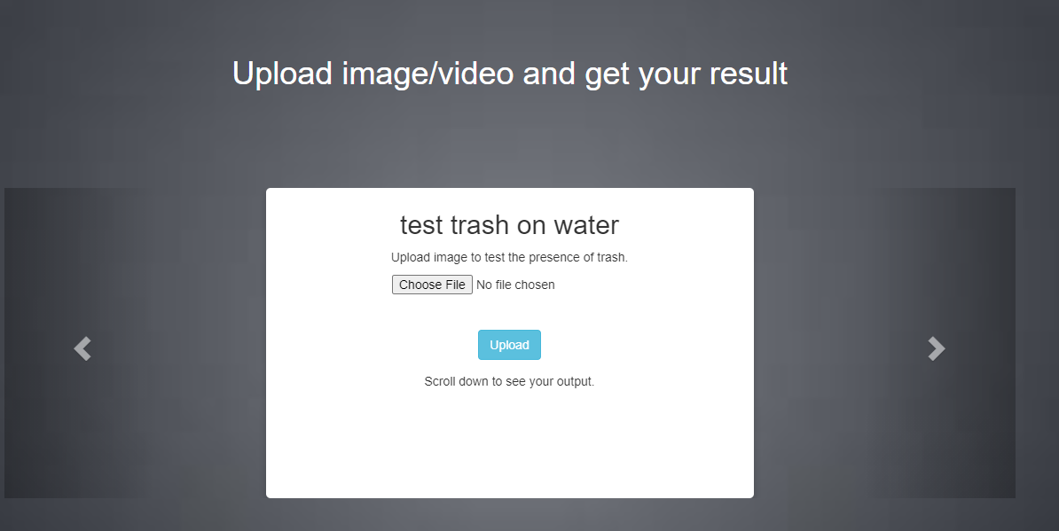
Results

Slide 33
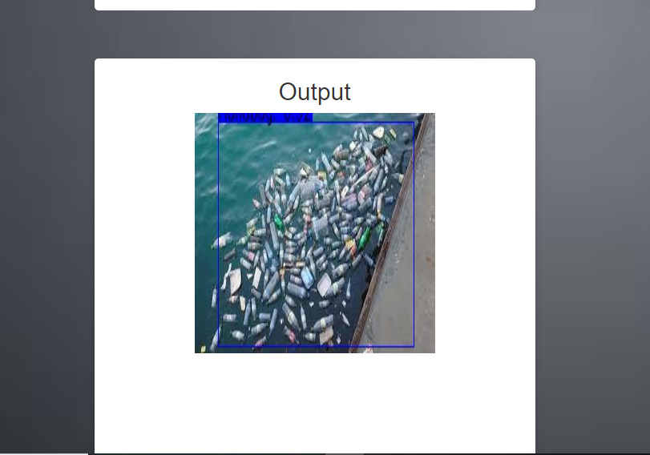
Results(Contd..)

Slide 34
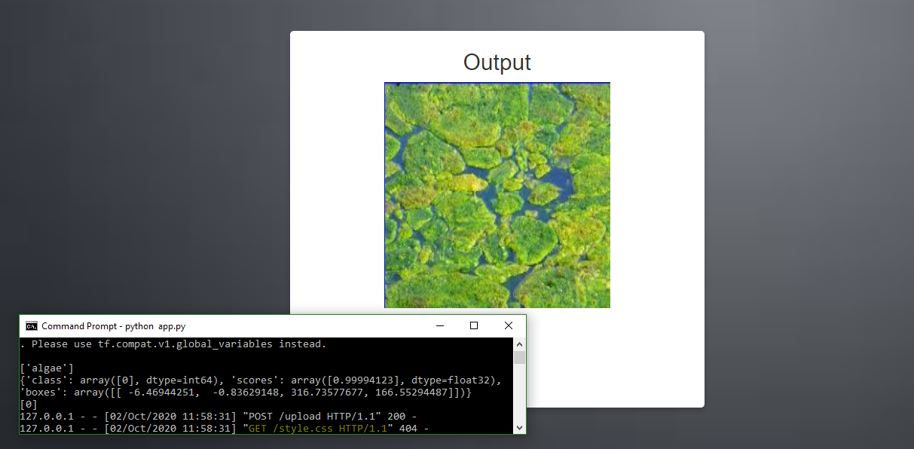
Results(contd..)

Slide 35
Comparison and Analysis
Name | Model | Class | Accuracy (mAp) | Time
Trash on water | YOLO V4 Darknet | Single class | 70 | 20.65sec
Algae detection | YOLO V4 Darknet | Single class | 81.43 | 20.65 sec
Algae detection | Mask RCNN | Single class | 82.4 | 1:10 sec
Algae and trash detection | YOLO V4 Darknet | Multiclass | 80 | 21.65 sec
Algae and trash detection | Mask RCNN | Multiclass | 92 | 1:10 sec

Slide 36
Work Done
YOLO V4- Tiny
In order to deploy the model in raspberry pi (lower end devices). We trained a lighter version model using YOLO V4 tiny.
We have to trade some accuracy in order to make the model lighter and for higher frame rate.

Slide 37
Work Done (Contd…)
Transfer learning on darknet model(darkent.conv.29) with YOLO V4 Tiny.
Train test split: 90% training data,10%test data.
Generated train.txt and test.txt files that contains the paths to all the images of training set and test set respectively.
Classes: algae, trash on water(multi class)
Iterations: 5000
Batch size: 32
Mean Average Precision(mAp) : 50.04

Slide 38
Work Done
Deployed the lighter version of the model in the mobile phone (android).
Developed the mobile app with flutter (android studio)
Steps :
Train the YOLO-Darknet model and save the weights.
Convert Darknet Model to TensorFlow Lite
Export Weights for Future Inference
Deploy on Device

Slide 39
Work Done(cntd..)
Convert Darknet Model to TensorFlow Lite
Darknet produces a .weights file for internal use in the Darknet framework. To use it with TensorFlow Lite, we need to convert it. For this, we used the tool TensorFlow-YOLOv4-TFLite.
This tool uses the COCO dataset as a base, so we changed the classes to our custom ones.
We converted the model from darknet to tensorflow SavedModel, then from TensorFlow Saved model to TensorFlow Lite, both with simple commands.

Slide 40
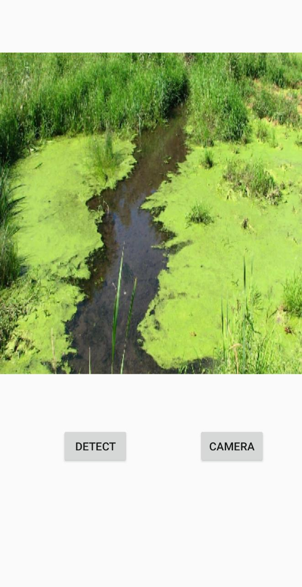
Results

Slide 41
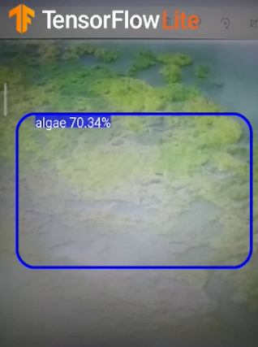
Results (Contd..)

Slide 42
Challenges
Difficulty in installing the required modules in raspberry pi due to lack of hardware.
Pollution detection with image thresholding is not done due to lack of hardware(turbidity sensor) to prepare a dataset.
Couldn’t integrate the models with drone due to lack of hardware.

Slide 43
References
[1] Samantaray, Arabinda & Yang, Baijian & Dietz, J. & Min, Byung-Cheol. (2018). Algae Detection Using Computer Vision and Deep Learning.
[2] U. Shafi, R. Mumtaz, H. Anwar, A. M. Qamar and H. Khurshid, "Surface Water Pollution Detection using Internet of Things," 2018 15th International Conference on Smart Cities: Improving Quality of Life Using ICT & IoT (HONET-ICT), Islamabad, 2018, pp. 92-96.

Slide 44
References (Contd…)
[3] V. Karnawat and S. L. Patil, "Turbidity detection using image processing," 2016 International Conference on Computing, Communication and Automation (ICCCA), Noida, 2016, pp. 1086-1089.
https://pjreddie.com/darknet/yolo/

Slide 45
Thank You

